Slide 1
Question Answering Using Enhanced Lexical Semantic Models
Scott Wen-tau Yih
Joint work with Ming-Wei Chang, Chris Meek, Andrzej Pastusiak
Microsoft Research
The 51st Annual Meeting of the Association for Computational Linguistics (ACL-2013)

Slide 2
Task – Answer Sentence Selection
Given a factoid question, find the sentence that
Contains the answer
Can sufficiently support the answer
Q: Who won the best actor Oscar in 1973?
S₁: Jack Lemmon was awarded the Best Actor Oscar for Save the Tiger (1973).
S₂: Academy award winner Kevin Spacey said that Jack Lemmon is remembered as always making time for others.

Slide 3
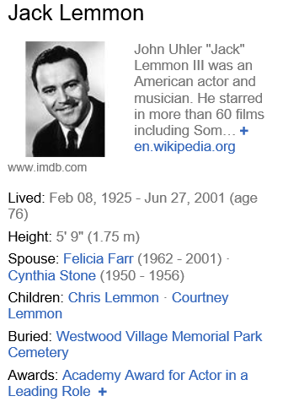
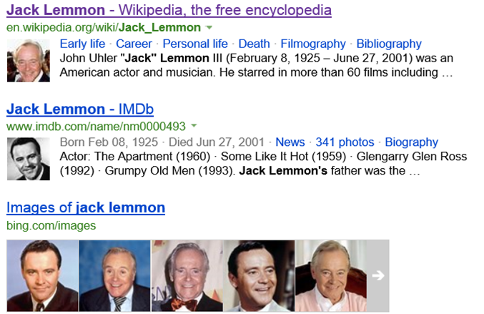
Lemmon was awarded the Best Supporting Actor Oscar in 1956 for Mister Roberts (1955) and the Best Actor Oscar for Save the Tiger (1973), becoming the first actor to achieve this rare double…
Source: Jack Lemmon -- Wikipedia
Who won the best actor Oscar in 1973?

Slide 4
Dependency Tree Matching Approaches
Tree edit-distance [Punyakanok, Roth & Yih, 2004]
Represent question and sentence using their dependency trees
Measure their distance by the minimal number of edit operations: change, delete & insert
Quasi-synchronous grammar [Wang et al., 2007]
Tree-edit CRF [Wang & Manning, 2010]
Discriminative learning on tree-edit features [Heilman & Smith, 2010; Yao et al., 2013]

Slide 5
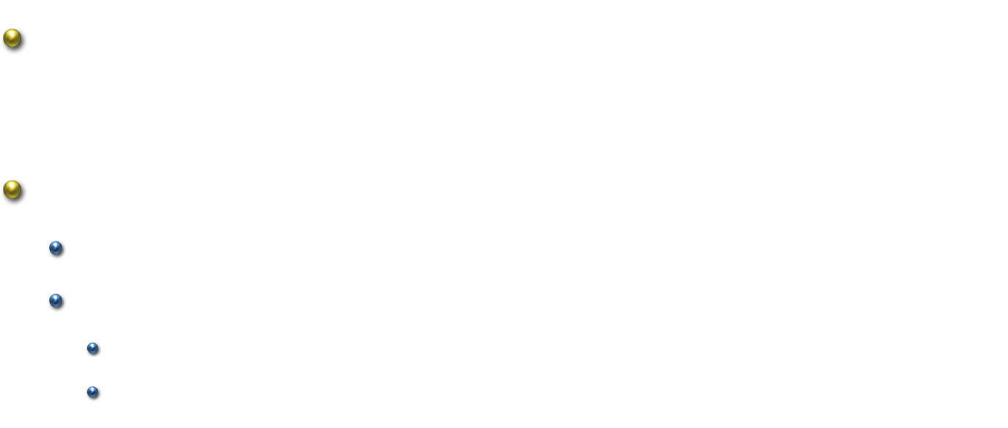
Issues of Dependency Tree Matching
Dependency tree captures mostly syntactic relations.
Tree matching is complicated.
High run-time cost
Computational complexity: $O(V⋅V^{′}⋅L^{2}⋅L^{′2})$ [Tai, 1997]
$V$ and $V^{′}$ are the numbers of nodes respectively of trees $T$ and $T’$
$L$ and $L^{′}$ are the maximum depths respectively of trees $T$ and $T’$

Slide 6
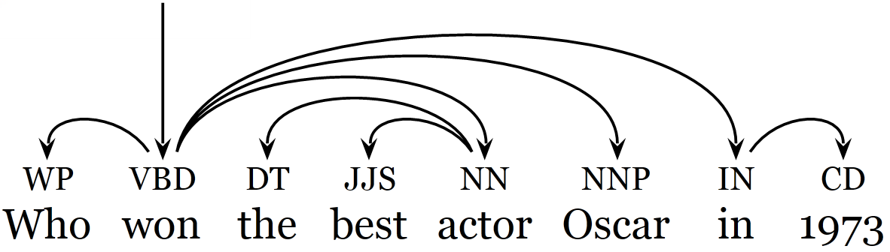
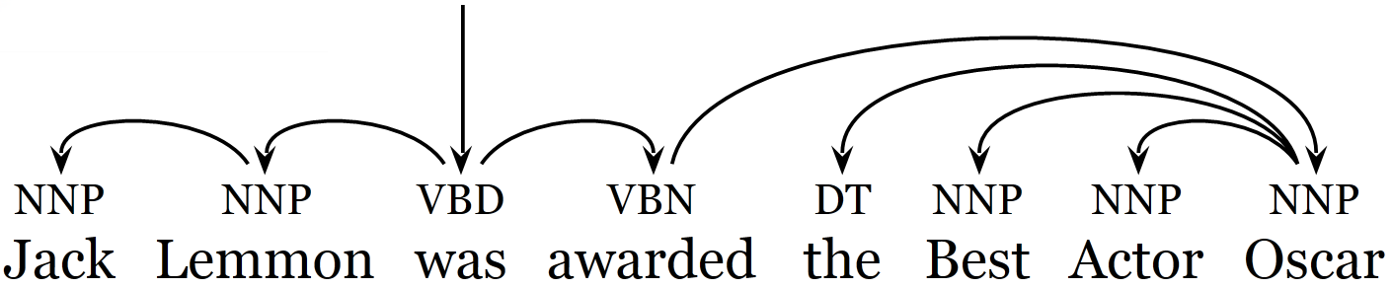
Match the Surface Forms Directly
Q: Who won the best actor Oscar in 1973?
Can matching Q & S directly perform comparably?
S: Jack Lemmon was awarded the Best Actor Oscar.

Slide 7
Match the Surface Forms Directly
Q: Who won the best actor Oscar in 1973?
S: Jack Lemmon was awarded the Best Actor Oscar.
Using a simple word alignment setting
Link words in Q that are related to words in S
Determine whether two words can be semantically associated using recently developed lexical semantic models

Slide 8
Main Results
Investigate unstructured and structured models that incorporate rich lexical semantic information
Enhanced lexical semantic models (beyond WordNet) are crucial in improving performance
Simple unstructured BoW models become very competitive
Outperform previous tree-matching approaches

Slide 9
Outline
Introduction
Problem definition
Lexical semantic models
QA matching models
Experiments
Conclusions

Slide 10
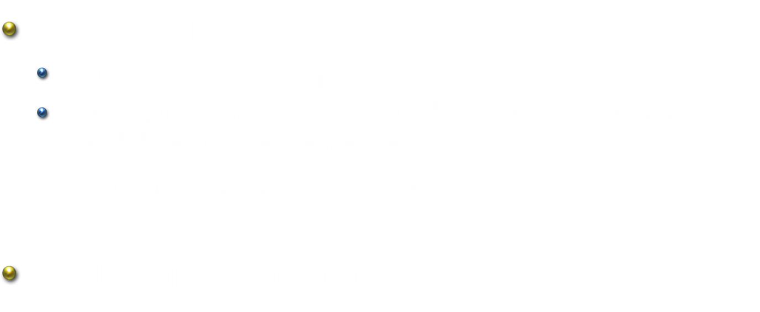
Problem Definition
Supervised setting
Question set: $𝒬=\left\{q_{1}, q_{2}⋯, q_{m}\right\}$
Each question $q_{i}$ is associated with a list of labeled candidate answer sentences: $\left\{\left(y_{i_{1}},s_{i_{1}}\right),\left(y_{i_{2}},s_{i_{2}}\right),⋯,\left(y_{i_{n}},s_{i_{n}}\right)\right\}$
Goal: Learn a classifier $f\left(q_{i}, {s_{i}}_{j}\right)→ℛ$

Slide 11


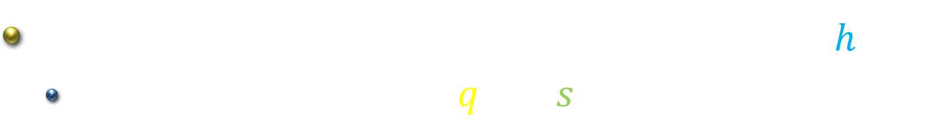


Word Alignment View
What is the fastest car in the world?
The Jaguar XJ220 is the dearest, fastest and most sought after car on the planet.
$$h$$
[Harabagiu & Moldovan, 2001]
Assume that there is an underlying structure $h$
Describe which words in $q$ and $s$ can be associated
Words that are semantically related

Slide 12
Outline
Introduction
Problem definition
Lexical semantic models
Synonymy/Antonymy
Hypernymy/Hyponymy (the Is-A relation)
Semantic word similarity
QA matching models
Experiments
Conclusions

Slide 13
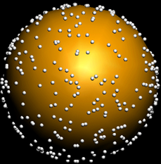
Synonymy/Antonymy
Synonyms can be easily found in a thesaurus
Degree of synonymy provides more information
ship vs. boat
Polarity Inducing LSA (PILSA) [Yih, Zweig & Platt, EMNLP-CoNLL-12]
A vector space model that encodes polarity information
Synonyms cluster together in this space
Antonyms lie at the opposite ends of a unit sphere
burning
hot
freezing
cold

Slide 14
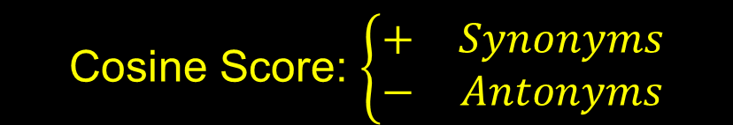
Polarity Inducing Latent Semantic Analysis [Yih, Zweig & Platt, EMNLP-CoNLL-12]
Acrimony: rancor, conflict, bitterness; goodwill, affection
Affection: goodwill, tenderness, fondness; acrimony, rancor
Inducing polarity
 | acrimony | rancor | goodwill | affection | …
Group 1: “acrimony” | 4.73 | 6.01 | -5.81 | -4.86 | …
Group 2: “affection” | -3.78 | -5.23 | 6.21 | 5.15 | …
… | … | … | … | … | …
Cosine Score: $\left\{\begin{matrix}+ & Synonyms \\ − & Antonyms\end{matrix}\right.$

Slide 15
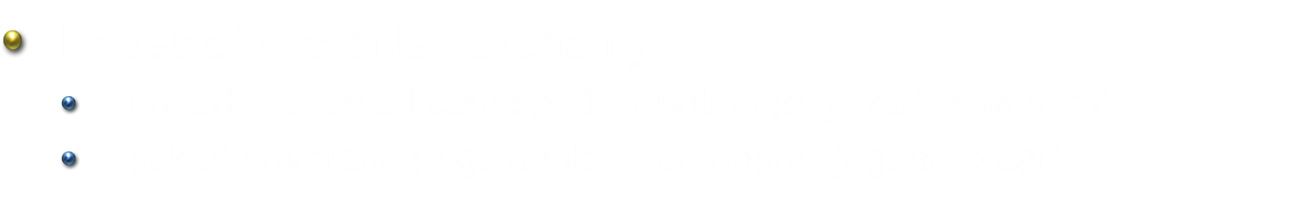
Hypernymy/Hyponymy (the Is-A relation)
Q: What color is Saturn? S: Saturn is a giant gas planet with brown and beige clouds.
Q: Who wrote Moonlight Sonata? S: Ludwig van Beethoven composed the Moonlight Sonata in 1801.
Issues of WordNet taxonomy
Limited or skewed concept distribution (e.g., cat $⇒$ woman)
Lack of coverage (e.g., apple $⇒$ company, jaguar $⇒$ car)

Slide 16
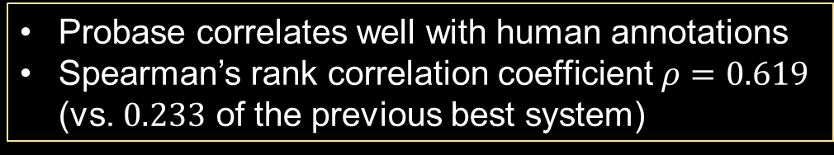
Probase [Wu et al. 2012]
A KB that contains 2.7 million concepts
Relations discovered by Hearst patterns from 1.68 billion Web pages
Degree of relations based on frequency of term co-occurrences
Evaluated on SemEval-12 Relational Similarity [Zhila et al., NAACL-HLT-2013]
“Y is a kind of X” – What is the most illustrative example word pair?
X | Y
automobile | van
wheat | bread
weather | rain
politician | senator
Probase correlates well with human annotations
Spearman’s rank correlation coefficient $ρ=0.619$ (vs. $0.233$ of the previous best system)

Slide 17
Semantic Word Similarity
A “back-off” solution when the exact lexical relation is unclear
Measuring Semantic Word Similarity
Vector space model (VSM)
Similarity score is derived by cosine
Heterogeneous VSMs [Yih & Qazvinian, HLT-NAACL-2012]
Wikipedia context vectors
RNN language model word embedding [Mikolov et al., 2010]
Clickthrough-based latent semantic model [Gao et al., SIGIR-2011]

Slide 18
Outline
Introduction
Problem definition
Lexical semantic models
QA matching models
Bag-of-words model
Learning latent structures
Experiments
Conclusions

Slide 19
Bag-of-Words Model (1/2)
Word Alignment – Complete bipartite matching
Every word in question maps to every word in sentence
What is the fastest car in the world?
The Jaguar XJ220 is the dearest, fastest and most sought after car on the planet.

Slide 20
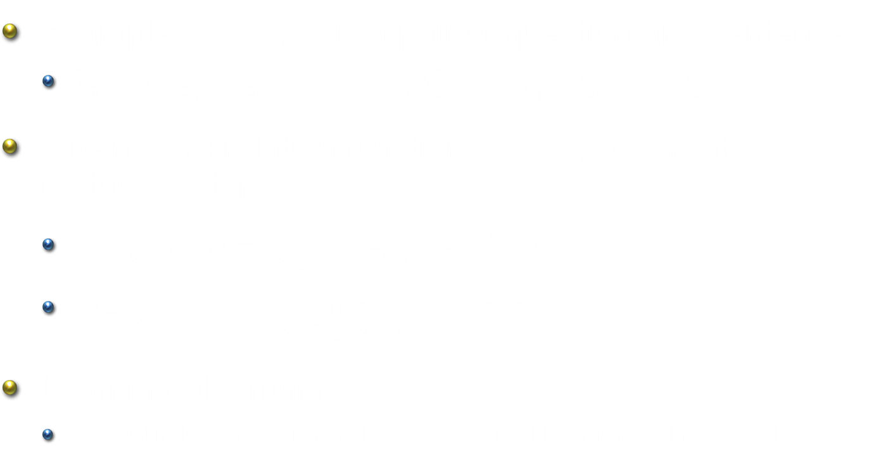
Bag-of-Words Model (2/2)
Example $x=(q,s)$ is a pair of question and sentence
$V_{q}=\{w_{q_{1} },w_{q_{2} }, ⋯, w_{q_{m} }\}$, $V_{s}=\{w_{s_{1} },w_{s_{2} }, ⋯, w_{s_{n} }\}$
Given word relation functions $φ_{1}, ⋯, φ_{d}$, create a $ℛ^{2d}$ feature vector
${Φ_{avg}}_{j}\left(q,s\right)=\frac{1}{mn}\sum_{w_{q}∈V_{q},w_{s}∈V_{s}}{φ_{j}\left(w_{q}, w_{s}\right)}$
${Φ_{max}}_{j}\left(q,s\right)=\max_{w_{q}∈V_{q},w_{s}∈V_{s}}{φ_{j}(w_{q}, w_{s})}$
Learning algorithms
Logistic Regression (LR) & Boosted Decision Trees (BDT)

Slide 21
Latent Word Alignment Structures (1/2)
Issue of the bag-of-words models
Unrelated parts of sentence will be paired with words in question
Q: Which was the first movie that James Dean was in? S: James Dean, who began as an actor on TV dramas, didn’t make his screen debut until 1951’s “Fixed Bayonet.”

Slide 22
Latent Word Alignment Structures (2/2)
The latent structure: word alignment with the many-to-one constraints
Each word in 𝑞 needs to be linked to a word in 𝑠.
Each word in 𝑠 can be linked to zero or more words in 𝑞.
What is the fastest car in the world?
The Jaguar XJ220 is the dearest, fastest and most sought after car on the planet.

Slide 23

Learning Latent Word Alignment Structures
LCLR Framework [Chang et al., NAACL-HLT 2010]
Change the decision function from $θ^{T}Φ(x)$ to $\underset{h∈H}{argmax}{θ^{T}Φ(x,h)}$
Candidate sentence 𝑠 correctly answers question 𝑞 if and only if the decision can be supported by the best alignment ℎ.
Feature Design – $Φ(x,h)$
$φ_{j}\left(x,h\right)=\frac{1}{\left|V_{q}\right|}\sum_{{(w}_{q},w_{s})∈h}{φ_{j}\left(w_{q}, w_{s}\right)}$
Objective function
$$\begin{matrix}\min_{θ}{\frac{1}{2}{\left\|θ\right\|}^{2}+C\sum_{i}{ξ_{i}^{2}}} \\ \text{s}\text{. }\text{t}\text{. }ξ_{i}≥1−y_{i}\max_{h}{θ^{T}Φ(x,h)}\end{matrix}$$

Slide 24
Outline
Introduction
Problem definition
Lexical semantic models
QA matching models
Experiments
Dataset
Evaluation metrics
Results
Conclusions

Slide 25
Dataset [Wang et al., EMNLP-CoNLL-2007]
Created based on TREC QA data
Manual judgment for each question/answer-sentence pair
Training – Q/A pairs from TREC 8-12
Clean: 5,919 manually judged Q/A pairs (100 questions)
Development and Test: Q/A pairs from TREC 13
Dev: 1,374 Q/A pairs (84 questions)
Test: 1,866 Q/A pairs (100 questions)

Slide 26
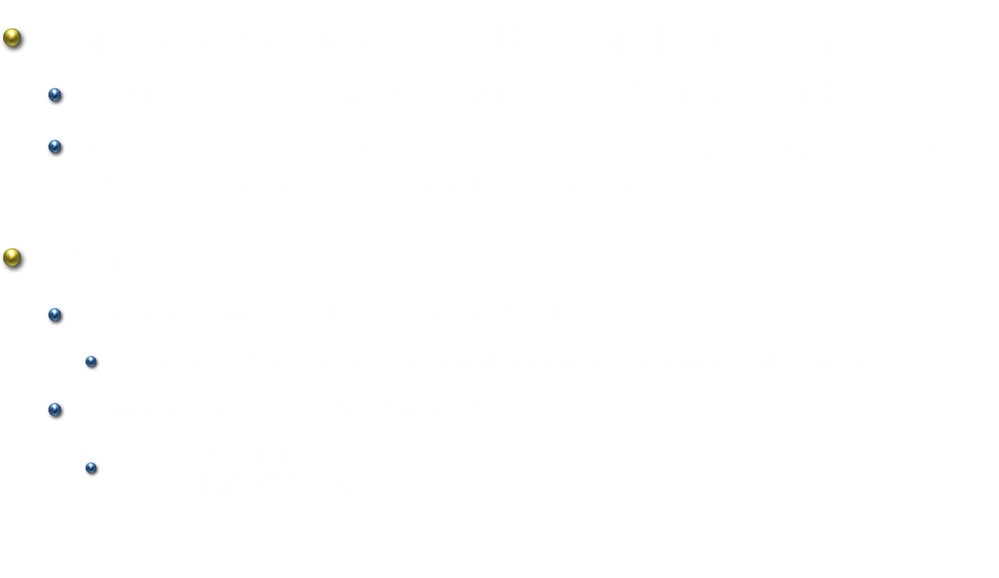
Evaluation
For each question, rank the candidate sentences
Sentences with more than 40 words are excluded
Questions with only positive or only negative sentences are excluded (only 68 questions in the test set left)
Metrics
Mean Average Precision (MAP)
Average Precision: area under the precision-recall curve
Mean Reciprocal Rank (MRR)
𝑀𝑅𝑅=$\frac{1}{\left|Q\right|}\sum_{i=1}^{\left|Q\right|}{\frac{1}{{rank}_{i}}}$

Slide 27
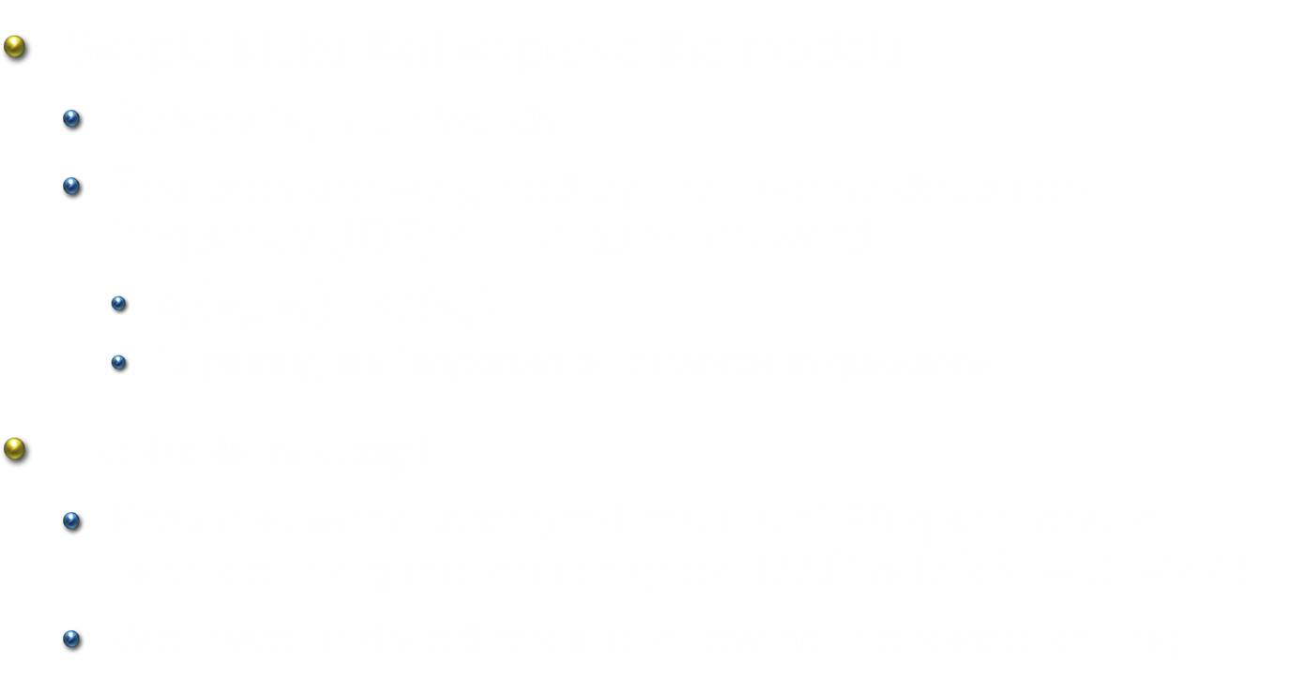
Implementation Details
Simple tricks that improve the models
Removing stop words
Features are weighted by the inverse document frequency (IDF) of the question word
$φ_{j}\left(w_{q}, w_{s}\right)⋅idf(w_{q})$
Capturing the “importance” of words in questions
Evaluation script
Previous work compared results of 68 questions to labels of 72 questions (highest MAP & MRR $→$ 0.9444)
We have updated results following the same setting.

Slide 28
Results – BDT vs. LCLR
I&L: Identical Word & Lemma Match

Slide 29
Results – BDT vs. LCLR
WN: WordNet Syn, Ant, Hyper/Hypo

Slide 30
Results – BDT vs. LCLR
LS: Enhanced Lexical Semantics

Slide 31
Results – BDT vs. LCLR
NER&AnsType: Named Entity & Answer Type Checking

Slide 32
Results – LCLR vs. TED-based Methods
*Updated numbers; different from the version in the proceedings

Slide 33
Limitation of Word Matching Models
Three reasons/sources of errors
Uncovered or inaccurate entity relations
Lack of robust question analysis
Need of high-level semantic representation and inference
Q: In what film is Gordon Gekko the main character?
S: He received a best actor Oscar in 1987 for this role as Gordon Gekko in “Wall Street”.

Slide 34
Conclusions
Answer sentence selection using word alignment
Leveraging enhanced lexical semantic models to find semantically related words
Key findings
Rich lexical semantic information improves both unstructured (BoW) and structured (LCLR) models
Outperform the dependency tree matching approaches
Future Work
Applications in community QA, paraphrasing, textual entailment
High-level semantic representations

